Slide 1

Texas State’s First Satellite Mission
An Independent Study in Pleiades Maia’s Software Development
Author: Taylor Gilg
Advisor: Dr. Mylene Queiroz de Farias
April 2025
CS4395.251

Slide 2






The Pleiades Five Mission
Pleiades 5 is an open-source, collaborative project between six universities that aims to construct, communicate with, and control small, Earth-orbiting satellites with more accessible and cost-effective embedded measuring devices.
The long-term goal is to combine extensive documentation, software tools, and small satellite engineering materials into an educational kit that will enables high schools and colleges without established space labs to gain hands-on experience with space mission development, satellite development, and a finished, space-ready satellite in a matter of months.
Notes:
Open Source Success:
There are a few projects out there like for example a project out of the University of Hawaii, but largely from what we’ve found many of the other projects touting themselves as open source are still very exclusive
From experience talking to other researchers in the small satellite space, many are very impressed by our mission’s progress.
Open source projects in general can be very hard to keep going and struggle to keep activity consistent but so far ours has been incredibly strong, even across multiple universities and space labs with various levels of experience and degrees of preoccupation with their own satellite projects beyond this one.

Slide 3
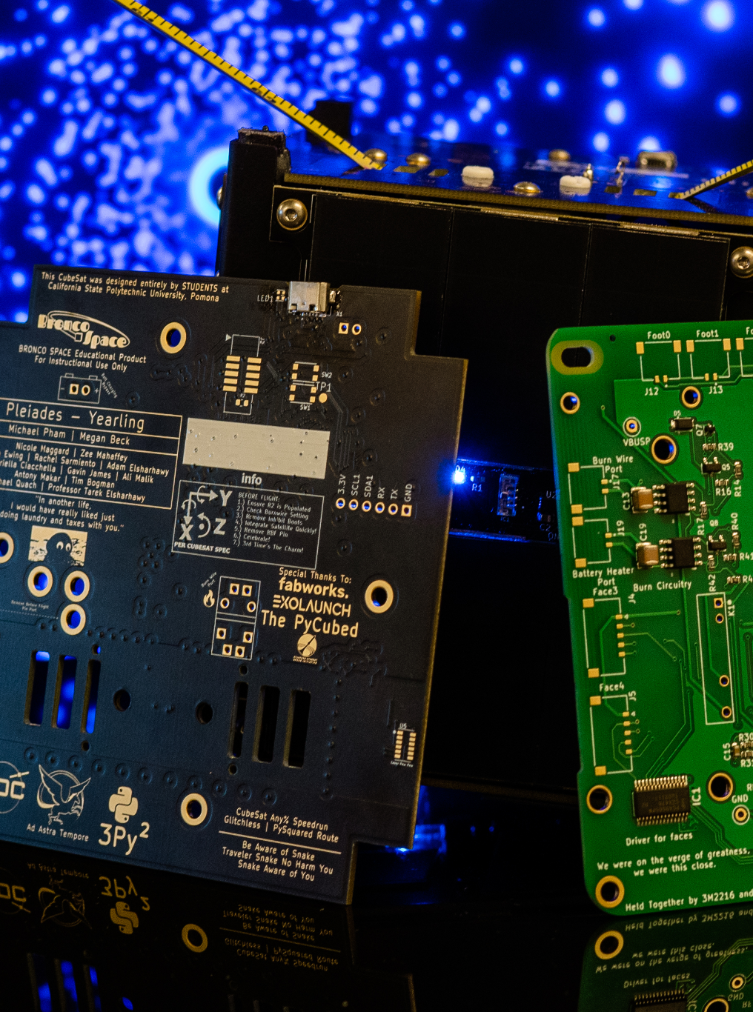
What Set Pleiades 5 Apart?
Section
12
The collaborative and educational nature of the mission has informed the choice to make the design not only straightforward and easy to work with, but as modular and customizable as possible.
The payload, various measuring devices and sensors, will be able to be easily switched out and replaced.
This makes missions with the kit endlessly customizable to different research questions and able to claim valuable novelty, something really important when it comes to landing grants, research opportunities, and further experiences in the field and industry.

Slide 4
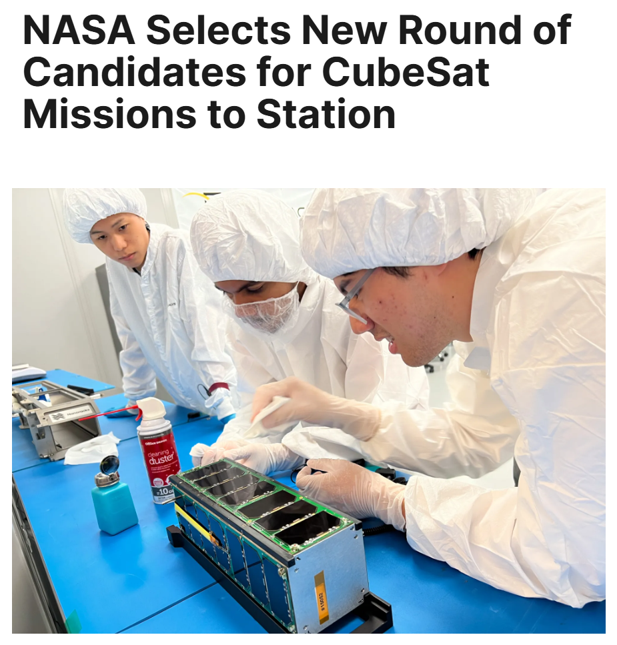
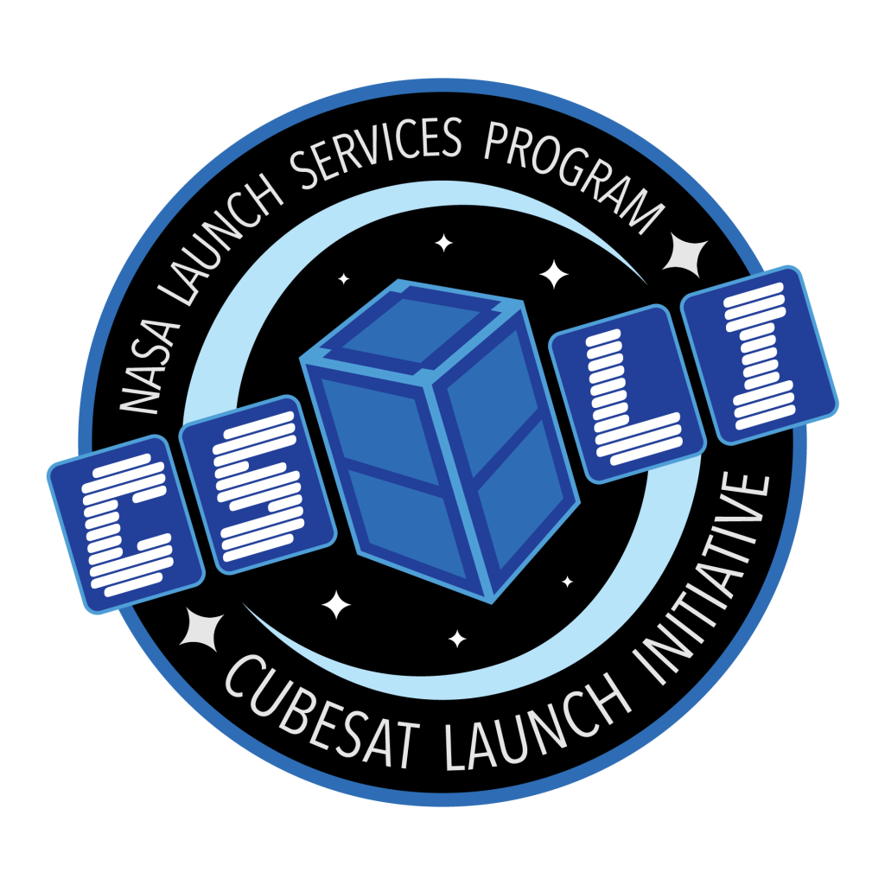
What Set Pleiades 5 Apart?
Section
12
With the help of the Pleiades project and similar collaborations of its kind, the construction cost of small satellite CubeSats has been reduced from approximately $50,000 to around $3,000 currently on the Pleiades project, although the goal is to go even lower to $1000.
Despite construction not being the largest cost involved in a satellite mission– that would be the launch provider and environmental testing – Pleiades 5’s launches and preliminary tests will be covered by NASA’s CubeSat Launch Initiative (CSLI)
Notes:
NASA’s CubeSat Launch Initiative provides opportunities for CubeSats built by U.S. educational institutions, and non-profit organizations, including informal educational institutions such as museums and science centers to fly on upcoming launches. Through innovative technology partnerships NASA provides these CubeSat developers a low-cost pathway to conduct scientific investigations and technology demonstrations in space, thus enabling students, teachers, and faculty to obtain hands-on flight hardware design, development, and build experience.

Slide 5
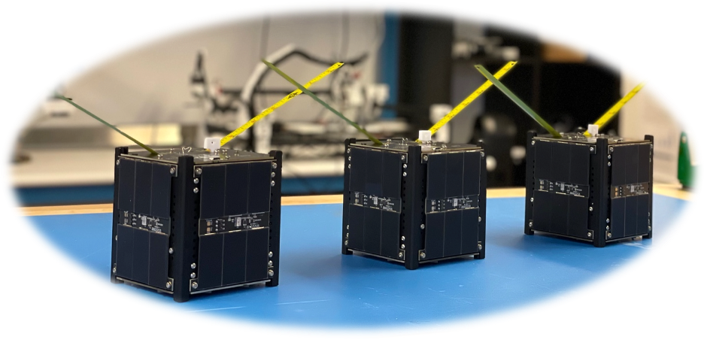

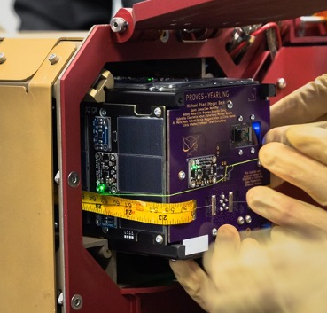
Pleiades Maia CubeSat
Pleiades Maia’s satellite is a 10x10x10cm cube called a CubeSat.
For its size, it is referred to as a 1U, larger satellites being multiple U large.
Inside the aluminum frame sits a flight controller board, battery board, and payload of sensors and measurement devices.
The satellite’s antenna attaches to the external flight board and each side is made up of solar panel boards, one side also including a camera.

Slide 6
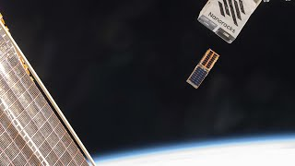
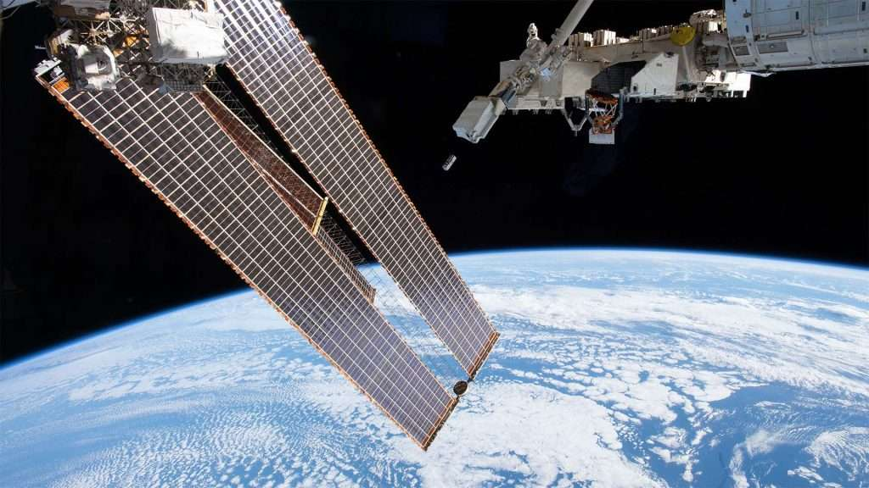

Intercepting with the ISS
Section
12
Pleiades Maia’s launch will have Texas State’s satellite intercept with the International Space Station (ISS).
Here, the astronauts on board will eject the craft from a specialized launcher built into the space station to deliver the satellite to its final destination in low earth orbit.

Slide 7
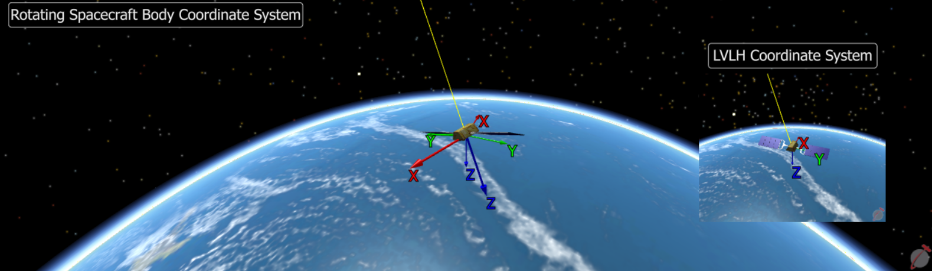
Pleiades Maia: Attitude Control On A Budget
Section
12
Pleiades Maia’s primary goal is to control satellite orientation with easily accessible, cost effective sensors.
Traditional methods rely on either:
Star/earth imaging + complex algorithms
Satellite communication networks
Both very resource intensive!
We plan to use:
Gyroscope – rotational speed
Magnetometer – magnetic field direction (craft and earth)
Light sensors – sun position
Magnetorquers – apply torque using Earth’s magnetic field
Notes:
Texas State University’s satellite mission, Pleiades Maia, is specifically focused on using more accessible, cost effective embedded measurement devices to control the movement of a satellite.
The goal is to be able to change the attitude, or where a particular face on the satellite is facing, with only a gyroscope, magnetometer, light sensors, and a magnetorquer.
Two of the most commonly used solutions to determine a satellite’s orientation and location in space are both incredibly expensive monetarily and resource wise. The solutions include: taking a picture of either the earth or nearby stars and using an intensive algorithm to calculate where the craft is, or have the accessibility to communicate with a network of other satellites in order to figure out a craft’s spacial data.
Using the rotational speed data from a gyroscope, the directional data of the magnetic field of the earth and the craft via the magnetometer, the direction of the sun via light sensors, and being able to apply force onto the satellite via the magnetorquers, we wish to direct the motion of and change the attitude of the spacecraft with more accessible, cost effective embedded measurement devices than the current alternatives.

Slide 8
Team Contributions
Section
12
Infrastructure & Tooling
CI pipelines & Pre-commit hooks
(automated testing & formatting)
PR Template
Make tool integration
Intellisense
Architecture & Code Quality
Refactored structure for modularity & maintainability
Introduced ADRs, type hinting, dependency injection
Config to replace hardcoded values
Testing & Documentation
Introduced PyTesting
Config checker
Developed structured logger
Began MkDocs-based documentation site
Notes:
In early December of 2024, the Texas State University team switched from developing a version of the Proves Kit with C++ based open source flight software, F Prime (F’). The software lacked a significant development community or much support past its documentation so the team decided to join Pleiades’ collaborators in further advancing the other software version of the Proves Kit using python based open source software CircuitPy.
Architecture
Introducing ADR (framework for handling device initialization failures)
Abstracting accessibility of hardware (more similar to FPrime structure)
Modularization of codebase and board versioning
Reduced cyclomatic complexity of codebase
Refactored hardware utilization with manager layer
Developed config file instead of hardcoding satellite variable settings
Implemented type hinting across code base
Integrating dependency injection pattern (seperate construction from call of service)

Slide 9
Team Contributions
Embedded Work & Firmware
Reintroduced SD card support & asyncio
Refactored NVM bit flags
Upstreamed firmware to CircuitPython
State of Health Reporting
Streamlined firmware onboarding
Ground Systems & Communication
Began ground station software development
Gained amateur radio certifications
Refactoring radio test
Outreach & Team Culture
Weekly demos, onboarding, & technical interviews
PyTexas conference presentation
Designed & preparing mission patches
Notes:
In early December of 2024, the Texas State University team switched from developing a version of the Proves Kit with C++ based open source flight software, F Prime (F’). The software lacked a significant development community or much support past its documentation so the team decided to join Pleiades’ collaborators in further advancing the other software version of the Proves Kit using python based open source software CircuitPy.
Architecture
Introducing ADR (framework for handling device initialization failures)
Abstracting accessibility of hardware (more similar to FPrime structure)
Modularization of codebase and board versioning
Reduced cyclomatic complexity of codebase
Refactored hardware utilization with manager layer
Developed config file instead of hardcoding satellite variable settings
Implemented type hinting across code base
Integrating dependency injection pattern (seperate construction from call of service)

Slide 10
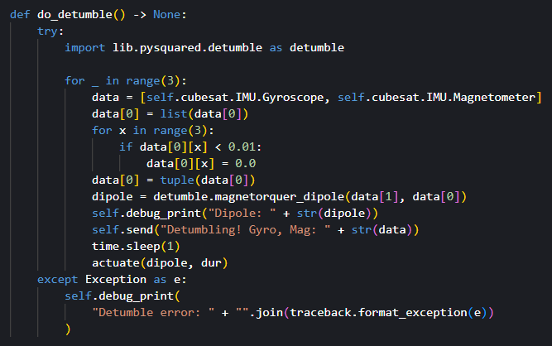
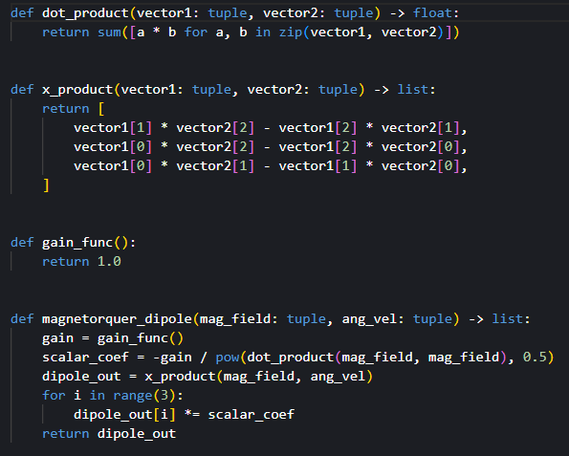
Introducing Pytests to PROVES kit
Focused on detumbling algorithm: stabilizing satellite orientation post-launch
Reads gyroscope & magnetometer data
Calculates torque via magnetorquer_dipole() to guide attitude control
Additional Contributions:
Automated tests via Make tools (make test)
Simulated realistic & edge-case sensor values
Helped serve as a resource for other team members with test writing

Slide 11
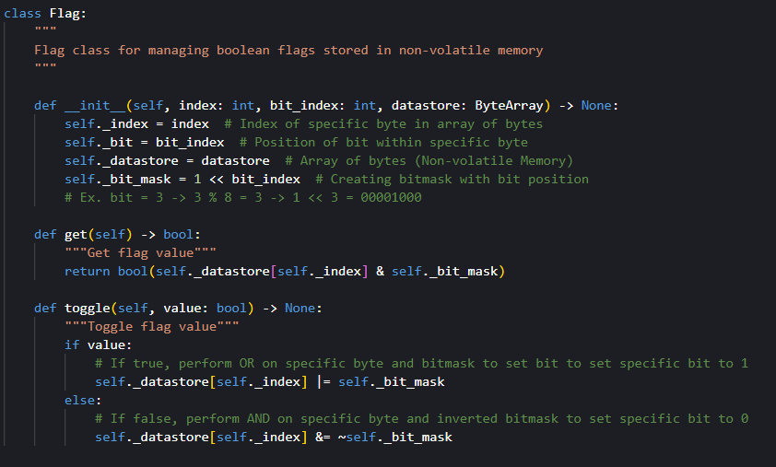
Bit Flag Refactor: NVM Storage Optimization
Reworked how critical system flags are stored in non-volatile memory (NVM):
Implemented a Flag class to manage single-bit values in a byte array
.get() → reads a specific bit (status check)
.toggle() → sets/clears a bit (update flag)
Why it Matters:
Tracks critical events: burn wire success, brownout, soft reboots, etc.
Enables data persistence across satellite reboots
Validated with PyTest:
Verified flag behavior in normal and edge-case conditions
Ensures long-term reliability and maintainability for flight software

Slide 12
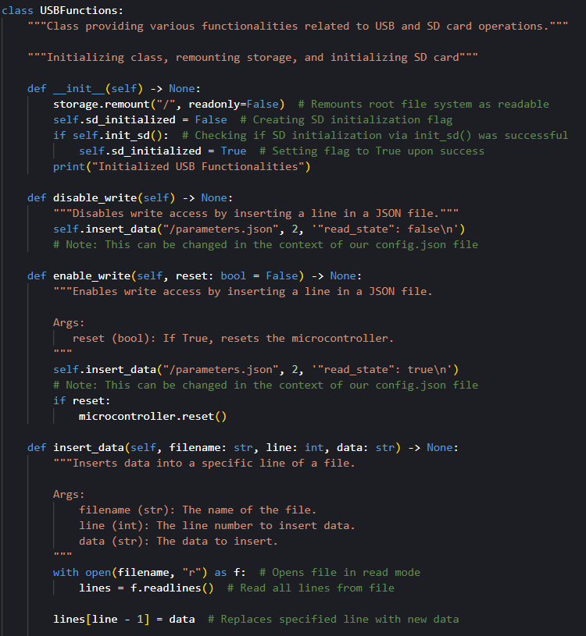
Reintegrating SD support
Type hinting & exception handling
Code documentation & structure improvements
SD Module Supports:
SD initialization & file mounting (/sd)
File operations: read, write, append, insert, delete
Directory management & unique filename creation
USB mode toggle via JSON config
Future Use:
Store system logs across reboots
Enable data downlink to ground stations
Support automated log cleanup to preserve memory space

Slide 13
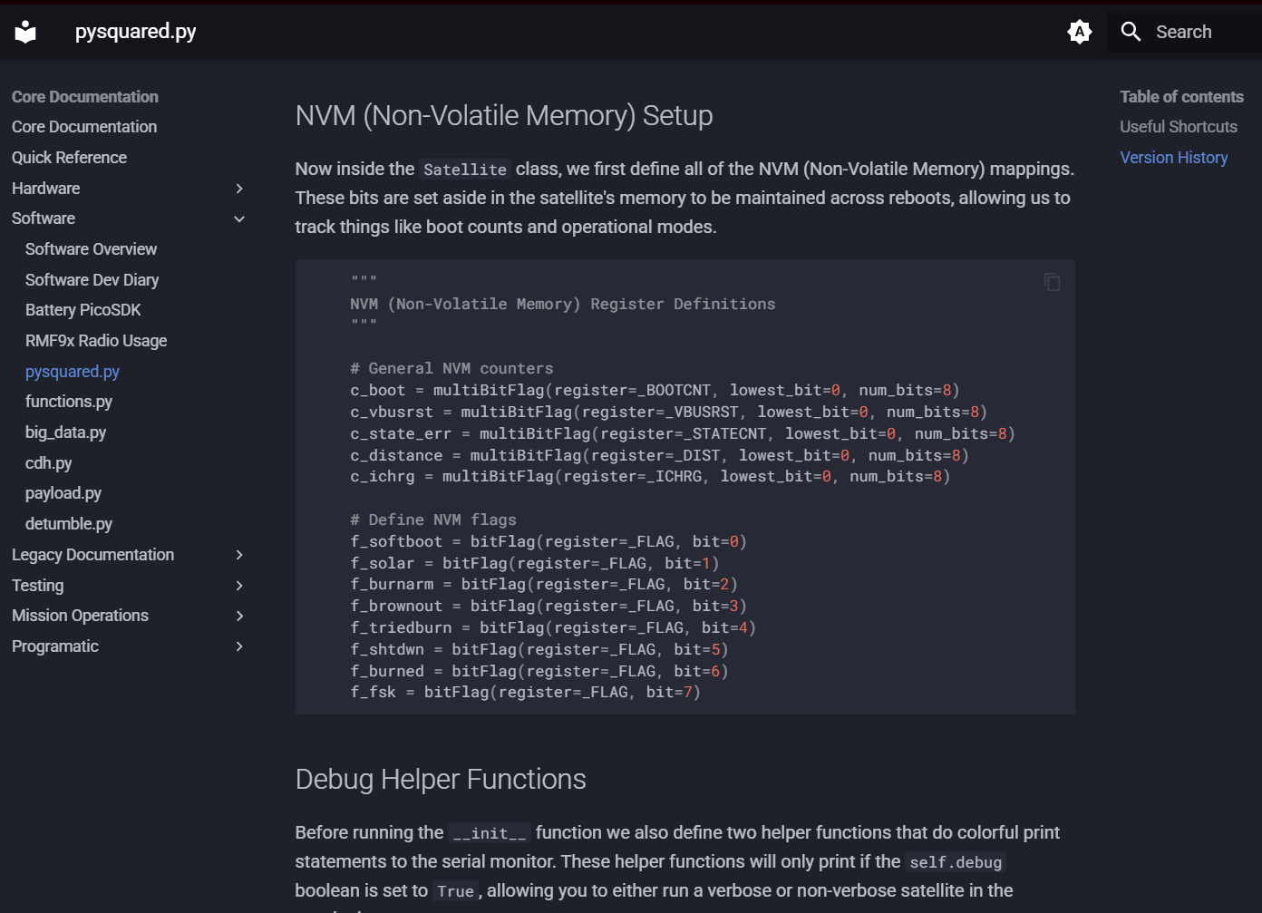
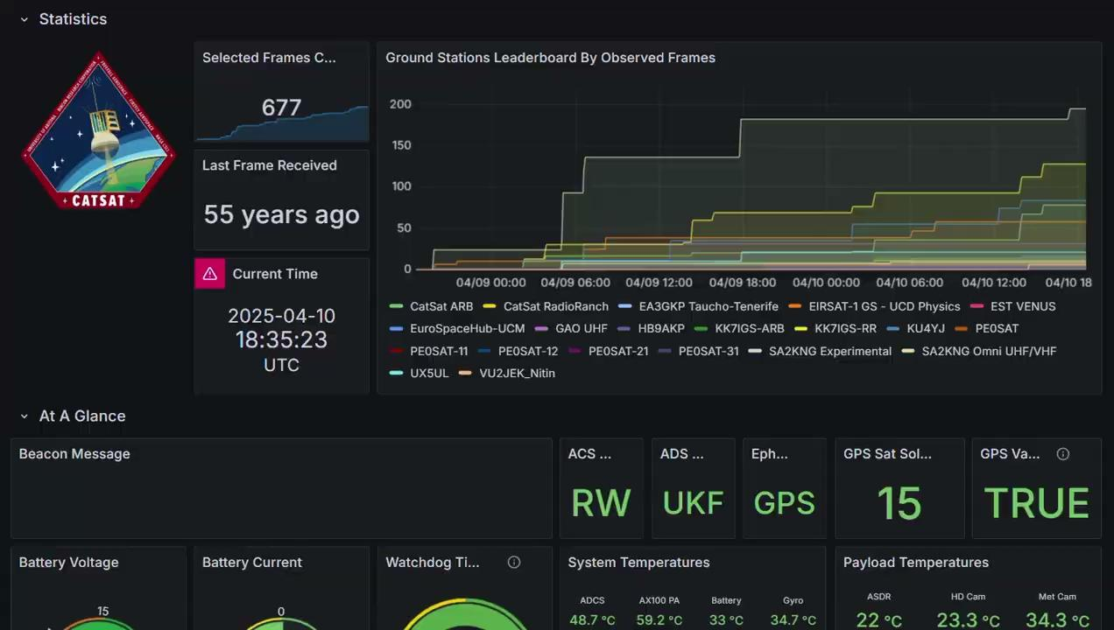
Next Tasks
Create comprehensive user facing documentation
MkDocs:
Static site generator, to build a browsable, locally launchable HTML website
Eventually host via Github Pages for automatic regeneration of documentation upon any changes to the code base
Integrate Grafana to ground station to display and monitor up to date satellite data
Finalizing preparations to send the Pleiades Maia mission patches I designed to production

Slide 14
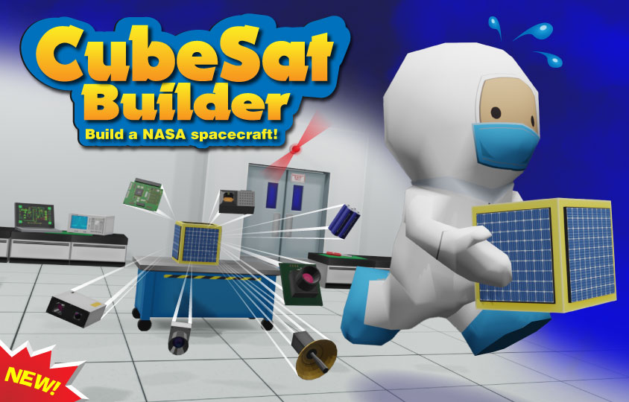
Conclusion & What Comes Next
Section
12
The team has made extensive contributions, resulting in significant improvements to software infrastructure, testing reliability, and system-level functionality.
The tasks I worked on this semester not only granted me technical experience, but also gave me valuable insight into how to communicate technical decisions clearly and contribute to a living codebase with mission-critical applications.
With a launch scheduled for early 2026 and our lab anxious to start on a new 2U satellite mission of our own, our team is preparing to complete core development by the end of summer 2025.

